Slide 1
Test Analysis for Developers
” If everybody is thinking alike, then somebody isn't thinking." ~ George S. Patten

Slide 2

Struggles…
Implementation over impact
Simplify complex problems
Happy path
Localised not big picture

Slide 3
Strengths…
Code base knowledge
What consumes & interfaces with what
What code is new/old & risky
Technical limits & constraints
Lower level testing

Slide 4
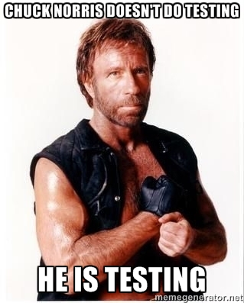
What’s test analysis anyway…
A set of heuristics/guides
Used to sharpen the saw
Generate ideas which may influence the implementation
A conversation

Slide 5

What is it not…
Absolute instructions
Complete
Test plans, scripts, artefacts
Complete – test ideas will emerge over time

Slide 6

Stage 0…
Three's please
Give me an example...
If we have a live one, great
If not, a recent one is cool

Slide 7
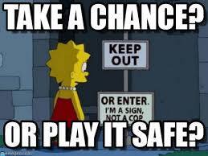
Stage 1 - Risks
10 risks
Stay on mission
You have to push your mind to get to 10
The idea is to stretch
Find the edge

Slide 8

Stage 2 - Mission
The primary concern
We want to test, investigate, evaluate
We can’t prove, ensure, guarantee
Encourages choices
One sentence, not much to ask?

Slide 9
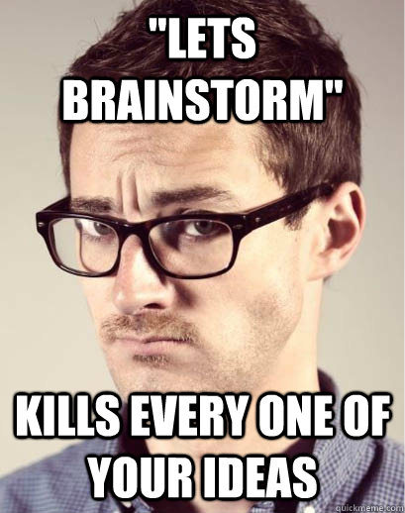
Stage 3 - Brainstorm
With a purpose
Pick a mnemonic from the handout
Or part(s) of a mnemonic(s)
No idea too outlandish

Slide 10

Stage 4 - Sessions
What & how meet why
Charters
Explore X
Using Y
To Discover Z
Helps us to think about:
Tools/Data/Techniques
Address your risks with sessions

Slide 11
Everyone reflect…

Slide 12
Remember, it’s a toolkit not a process…
* If you are doing lots of test analysis, the change is too big, complex or misunderstood. Slice.

Slide 13
End…

